Slide 1
Low-Latency Synchronous I/O For OpenZFS Using Persistent Memory
Christian Schwarz
Master Thesis Intermediate Presentation
Karlsruhe Institute of Technology - ITEC - OS Group
10 March 2021

Slide 2
Low-Latency Synchronous I/O For OpenZFS Using Persistent Memory
Christian Schwarz
Master Thesis Intermediate Presentation
Karlsruhe Institute of Technology - ITEC - OS Group
10 March 2021

Slide 3
Synchronous I/O
OpenZFS
Persistent Memory
fsync(), open(..., O_SYNC), sync(), etc.
Volume manager and file system. Storage is pooled.
Many file systems per storage pool.
Synchronous I/O semantics are supported through the ZFS Intent Log (ZIL), a logical write-ahead log maintained per file system.
Separate Log (SLOG) devices can be added to the pool as backing storage for the log entries. Fast and small device compared to slower main pool devices.
Memory-mapped persistent storage.
Low latency, byte-addressable.
I/O through load/store + cache flush + store barriers.

Slide 4
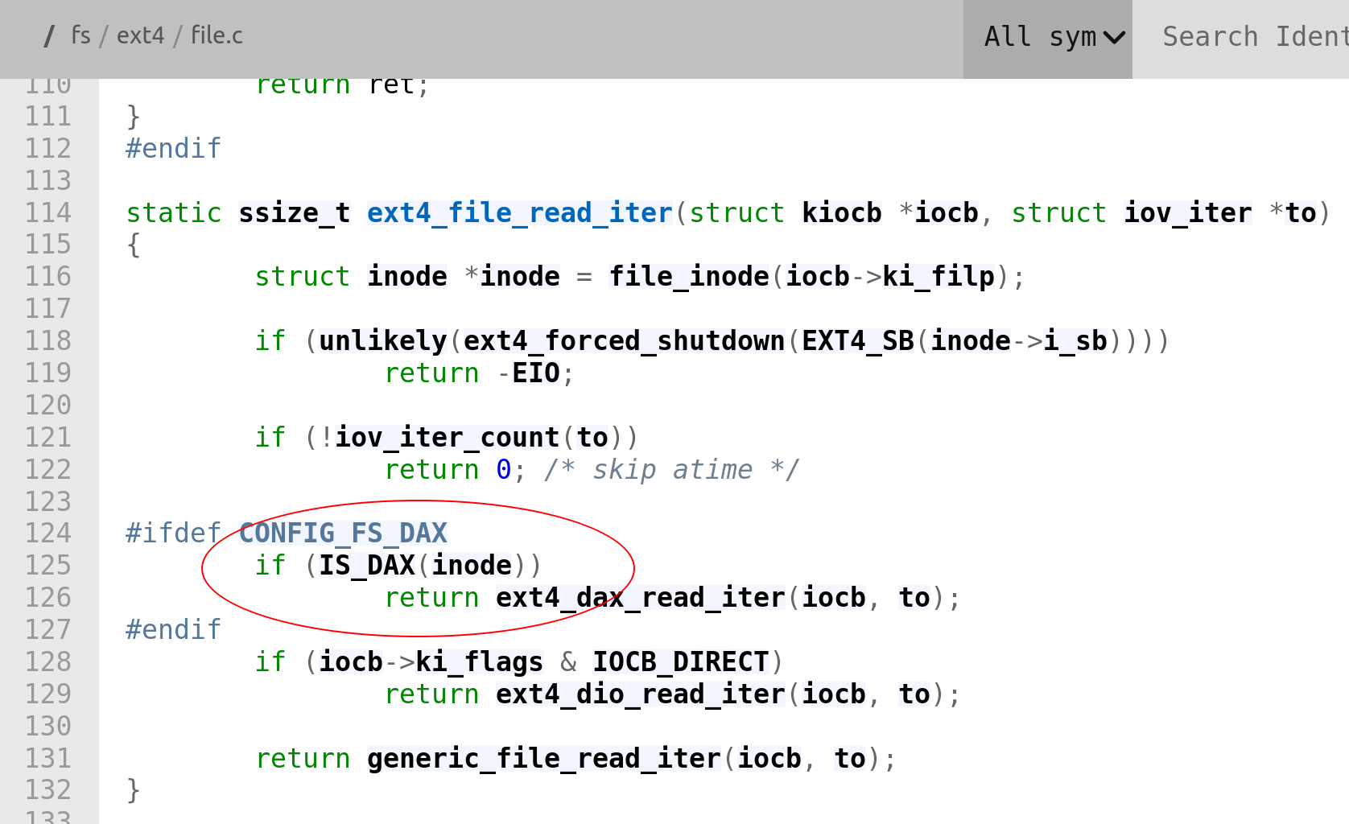
Linux, File Systems and Persistent Memory
PMEM shows up as /dev/pmemX.Y block device node.
Usable as a regular Linux block device: driver maps block IO to memcpy_flushcache().
Additional Direct Access (DAX) APIs that enable block device consumers to:
check whether block device is DAX (≈ PMEM)
translate LBA range ⇒ kernel virt addr range
⇒ conditionally support DAX-specific optimizations and features
ZFS is an out-of-tree kernel module and has no support for DAX.
https://elixir.bootlin.com/linux/latest/source/fs/ext4/file.c ; 2021-03-04

Slide 5
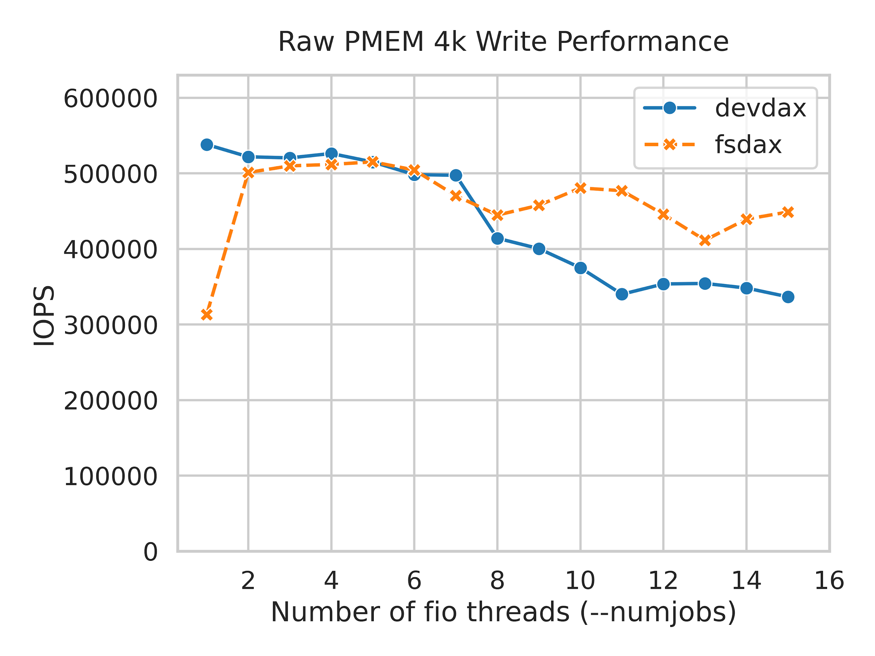
Raw Persistent Memory Performance
What is the performance potential of /dev/pmem for 4k random sync write workloads?
This is a typical workload for ZFS with a SLOG (storage virtualization, databases).
Benchmark:
Xeon Silver 4215 (single socket via isolcpus) 1 x 128 GB Optane-Module fio rw=randwrite bs=4k size=200M numjobs=X ioengine=dev-dax
devdax user-space access to PMEM
fsdax 4k sync O_DIRECT writes to /dev/pmem
A single PMEM DIMM is able to sustain ~500k random 4k writes before it starts queuing. Queuing does not significantly affect throughput while numjobs is less than the physical core count.

Slide 6
Using Persistent Memory as an OpenZFS SLOG
How effectively can ZFS utilize /dev/pmem as a SLOG?
Benchmark:
Same hardware as in previous benchmark. + 3 x Micron 7300 MAX 1.92TB NVMe for ZFS pool 10 partition each, all added to the pool as top-level VDEVs (= one big stripe).
Two additional measurement series: zil-lwb and async.
zil-lwb | --sync=1 | Current ZIL implementation’s performance.
async | --sync=0 | Asynchronous 4k writes. Only dirties in-DRAM state. Changes are written back to disks by a background thread.

Slide 7
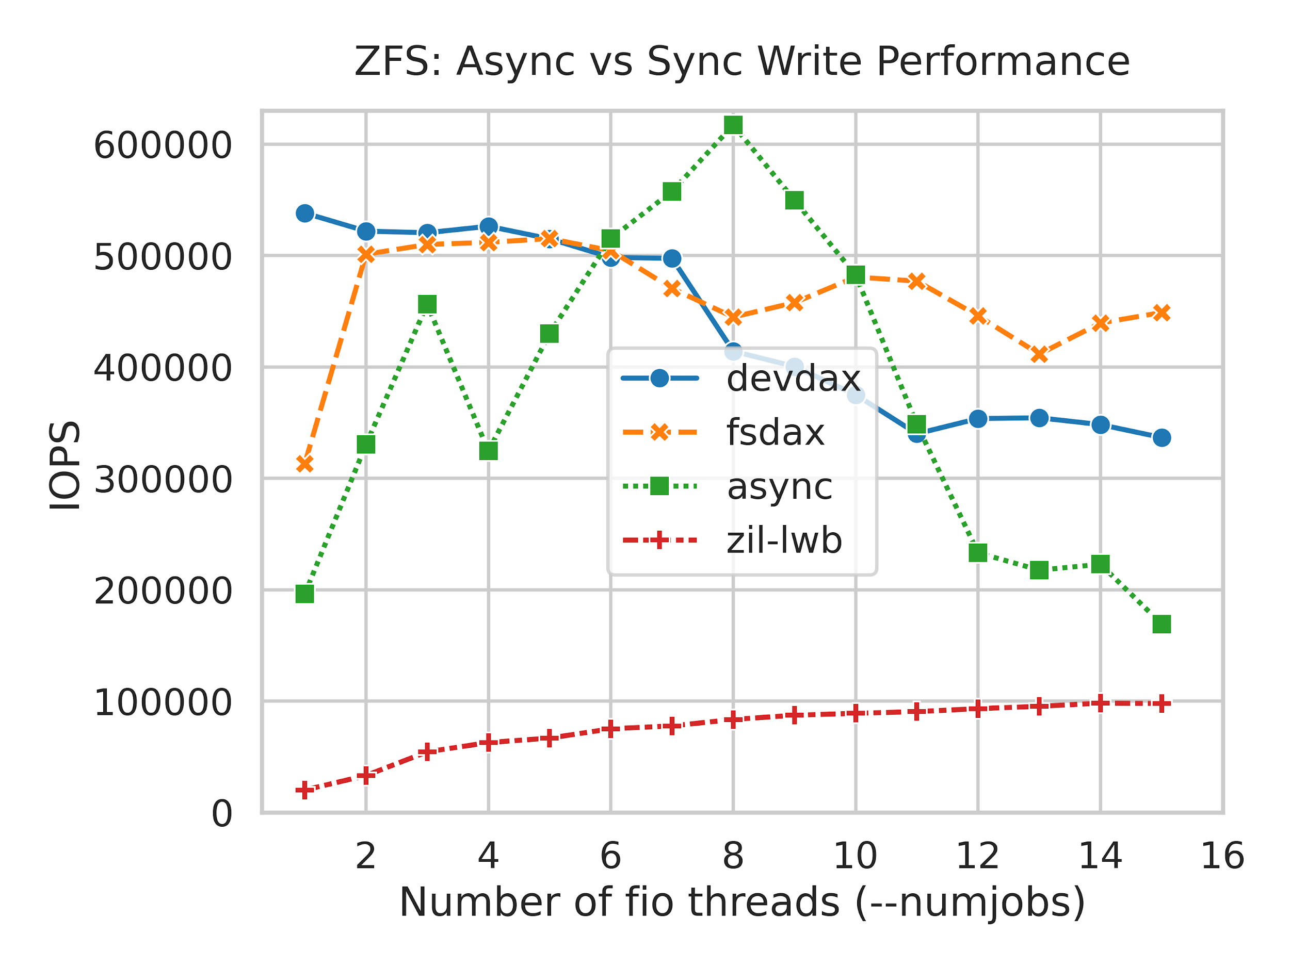
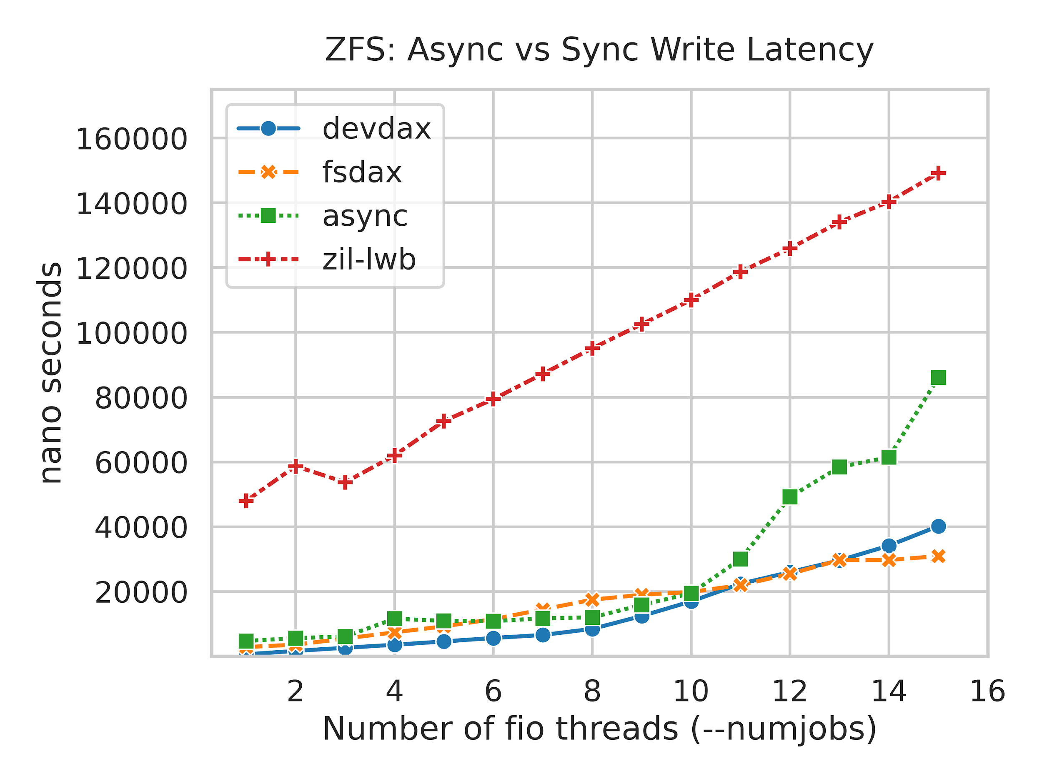
Using Persistent Memory as an OpenZFS SLOG
The ZIL adds between 44us and 72us of latency.
At numjobs=1 this is 10x the async latency.
⇒ZFS is unable to exploit PMEM performance.
latency[us] | 1 | 4 | 8
devdax | 0.6 | 3.6 | 8.5
fsdax | 2.9 | 7.4 | 17.5
async | 4.7 | 11.6 | 12.0
zil-lwb | 48.0 | 62.0 | 95.1

Slide 8
> Latency Analysis
What is causing the disproportional latency gap?
Method:
eBPF function boundary instrumentation using bpftrace ⇒ Aggregate sum of wall-clock time spent in subsystems involved in write() syscall.
Dissect aggregates based on the following model:
derived
measured
zfs_write
ZIL: LWB specific
async
zfs_log_write
zil_commit
ZIL: ITX
zil_process_commit_list
lwb-fill-timeout
lwb-ziowait
lwb-other
/dev/pmem driver
pmem
ZIO
ZIO: ZFS IO Pipeline
Note: Measurement overhead is significant (~10us per write() syscall @ 1 thread).

Slide 9
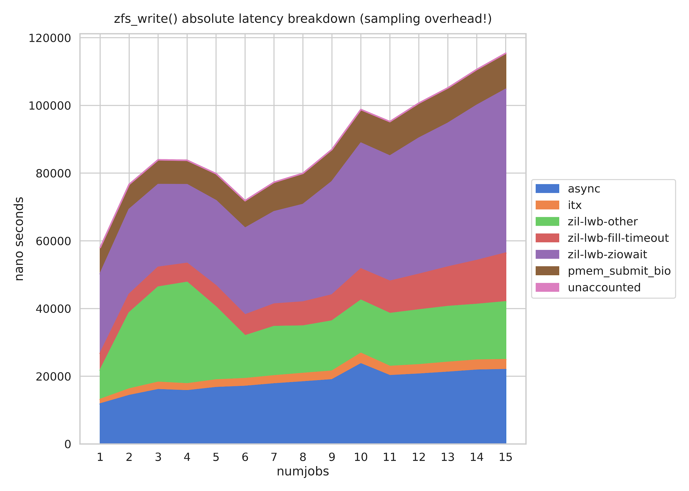
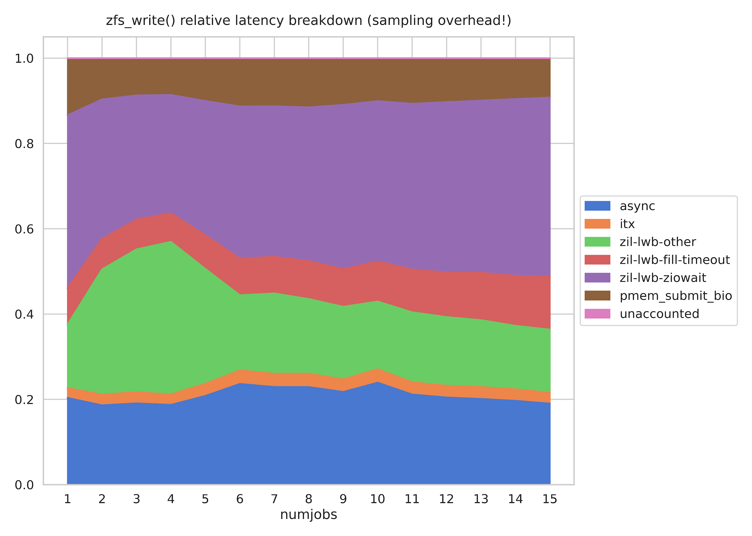
> Latency Analysis (ctd.)
Absolute
Relative
The ZIO pipeline is responsible for ~50% of total latency. ZIO overhead with low-latency devices is a known problem; no low-hanging fruit. LWBs add significant latency overhead as well and are unnecessary with PMEM.

Slide 10
Our Contribution: ZIL-PMEM
ZIL-PMEM is a new ZIL implementation that exclusively targets PMEM.
ZFS Integration
PMEM is a pool resource shared by all file systems.
Maintain existing ZFS / ZIL semantics: same guarantees, same entry format.
Support co-existence of ZIL-LWB and ZIL-PMEM.
Performance
Minimal latency overhead on the log write path.
- Leverage PMEM character- istics where useful.
⇒use DAX APIs
Multicore scalability.
Mechanism to avoid wasting CPU time if PMEM is overloaded.
Correctness
Crash-consistent logging.
Replay:
- logical dependencies
- crash-consistent
- data integrity checks

Slide 11
ZIL-PMEM Architecture
VFS
ZPL
ITX: common code. Persistence-related code: call vtable.
ZIL
...
ITX
ZIL vtable
Implements the ZIL vtable interface using the PRB data structure.
ZIL-PMEM
ZIL-LWB
...
per-file system
different
allocation
lifecyles
per pool
Central abstraction over PMEM.
PRB
Small in-DRAM structure; tracks chunk state.
Chunk
Chunk
...
...
PMEM device split into chunks. Chunks contain log entries.
PMEM DIMM
Main Pool

Slide 12
Basic In-PMEM Format
The PMEM DIMM is partitioned into chunks. A chunk has a 256B-aligned base address. Chunks contain a contiguous sequence of entries. The first entry starts at offset zero.
An entry consists of
a fixed-length header
a variable-length body
padding to the next 256B multiple.
The header contains the body’s length and checksum. A separate checksum protects the header fields.
Fixed-length
Header
Variable-length body
padding to next
256B
A zeroed-out header is always invalid.
0
0
0
0
Chunk #0
Chunk #1
Chunk #2
Chunk #3
Chunk #4

Slide 13
Traversal
Enumeration of all entries in a chunk is trivial:
Start at offset 0.
Read the fixed-size header (256B).
Validate header by checking header checksum. If invalid: end of sequence for this chunk.
Body length can now be trusted.
Move offset forward by 256 + body length.
Note: A zeroed-out header is always invalid.
Fixed-length
Header
Variable-length body
padding to next
256B
A zeroed-out header is always invalid.
0
0
0
0
Chunk #0
Chunk #1
Chunk #2
Chunk #3
Chunk #4

Slide 14
Writing Entries
Requirements:
Crash-consistently append an entry to the end of the sequence in a chunk.
Multicore scalability: efficiently handle concurrent writers on different cores.
Mechanism to avoid wasting CPU time if PMEM is overloaded.

Slide 15
Writing Entries: Crash-Consistent Append
Insertion offset points to zeroed-out header.
For offset == 0 the precondition is established by PRB when adding the chunk. For offset > 0 this algorithm guarantees it.
0
0
0
0
Write out body, padding, zero follow header; Flush & SFENCE;
Body and follow header will never be visited by traversal because it stops at the preceding invalid header.
0
0
0
0
0
0
0
0
Write out header; Flush caches; SFENCE;
Header partially written ⟺ checksum error
Header fully written ⟺ checksum ok
0
0
0
0
Traversal visits the entry and stops at the zeroed-out follow header.

Slide 16
Writing Entries: Scalability & Overload Handling
semaphore (max=4)
Per-committer fast path:
Thread acquires a committer slot.
If slot’s current chunk has space: write entry. Otherwise: slow path.
⇒No global coordination except semaphore.
⇒Entries are scattered across chunks (sorted back together by replay).
committer slots
committer’s current chunk
Slow path: Acquire mutex, then put committer’s full chunk on full list, get a new chunk from the free list,
then restart at fast path.
mutex + condition variable
global chunk lists
free chunks
full chunks
...

Slide 17
Writing Entries: Scalability & Overload Handling
Multicore scalability:
size(Chunks) >> max_size(Entry) ⇒ getting a new chunk is rare ⇒ no contention on PRB-wide mutex
PMEM overload handling: avoid on-CPU waiting.
Semaphore limits number of concurrent committers ⟺ writers to PMEM.
Size limit on a log entry. Larger entries are split. Each split requires re-acquisition of a committer slot.
Common entry format already supports splitting for WRITE records.
Current size limit: 16k.
TBD: determine whether other record types are significantly larger.
⇒ max concurrent write volume: ncommitters x 16k
Future work: auto-tuning algorithm.
General theme: space-time-tradeoff; lean heavily toward space. Acceptable because PMEM has high capacity (128 GiB in our case).

Slide 18
Replay
Requirements:
Attribute log entries to the file systems for which they were written.
Crash-consistency: if we crash during replay we must be able to resume.
Data integrity: detect bit errors in the log entries and do not replay them
Replay each log entry exactly once and respect logical dependencies.
Solution:
Attribution: GUID stored in the dataset metadata, repeated in each entry.
Crash-consistency: Based on current ZIL’s technique.
Data integrity: Fletcher checksum for body (ZFS has optimized code).
Dependencies: next slide.

Slide 19
Replay: Dependencies
The ZIL is a logical write-ahead log.
It is scoped to a file system (in contrast to finer-grained journaling, e.g. per-inode).
All operations that affect the file system namespace are queued in a single linked list**.
But changes within a file are queued per file (bearing some optimizations) and only moved to the file-system wide list if
file sync is requested (e.g. fsync() syscall) or
file-system wide sync semantics are requested (e.g. sync() syscall).
The file-system wide list is what we subsequently write into LWBs or to PMEM.
⇒ Minimum requirement: replay must happen in list order.
CREATE /a as object 42
WRITE 42 off=0, data=”A”
WRITE 42 off=8k, data=”B”
RENAME /a to /b
Entry #1
Entry #2
Entry #3
Entry #4

Slide 20
Replay: Dependencies (2)
But: for per-file log entries, full sequentiality is not semantically required.
Example: WRITE entries #2 and #3 are not overlapping. If they were written simultaneously by different threads; they are not logically interdependent.
WRITE 42 off=8k, data=”B”
CREATE /a as object 42
Entry #2
RENAME /a to /b
Entry #1
WRITE 42 off=0, data=”A”
Entry #4
Entry #3
Currently the ITX layer’s data structures enforce the fully sequential form. But a proof-of-concept has been presented at the OpenZFS Dev Summit 2020.
⇒ZIL-PMEM should be able to represent such diamond dependency chains.

Slide 21
Replay: Dependencies (3)
Representing diamond dependency chains:
gen=2, id=1 count=1
gen=1, id=1
gen=3,id=1
count=3
gen=2,id=2 count=1
Generation 1
Generation 2
Generation 3
Within the scope of a file system, entries are identified by (generation, id) in the header. The entry header also contains a running count of all entries written since gen 1.
⇒(generation, id) induces total ordering for replay.
⇒count is used to detect missing entries in generation G - 1 when replaying entry (G,1).
Have to start a new generation for an entry iff the entry depends on any previous entry.

Slide 22
Replay: Dependencies (4)
There is one more (significant) complication to this scheme to accommodate both
efficient garbage collection during logging
ZFS’s mechanism for coordinating on-disk changes (txg sync).
⇒ Insufficient time to discuss this here, but backup slides are available.

Slide 23
Replay: Algorithm (Intuition)
To replay a given file system FS:
Find all of FS’s entries (traversal algorithm + attribution by GUID).
Put entries into a sorted list (sorting key: (generation, id))
replay_position, count := (0,0), 0 if first replay attempt else restore from main pool
for entry in sorted_list:
if (entry.generation, entry.id) < replay_position: continue // already replayed
if entry.generation > replay_position.generation:
check entry.count == count; fail “missing entries” if they do not match
replay_position = (entry.generation, 0)
count++
replay_position.id = entry.id // must be monotonically increasing
in one tx:
replay entry
persist replay_position and count in main pool

Slide 24
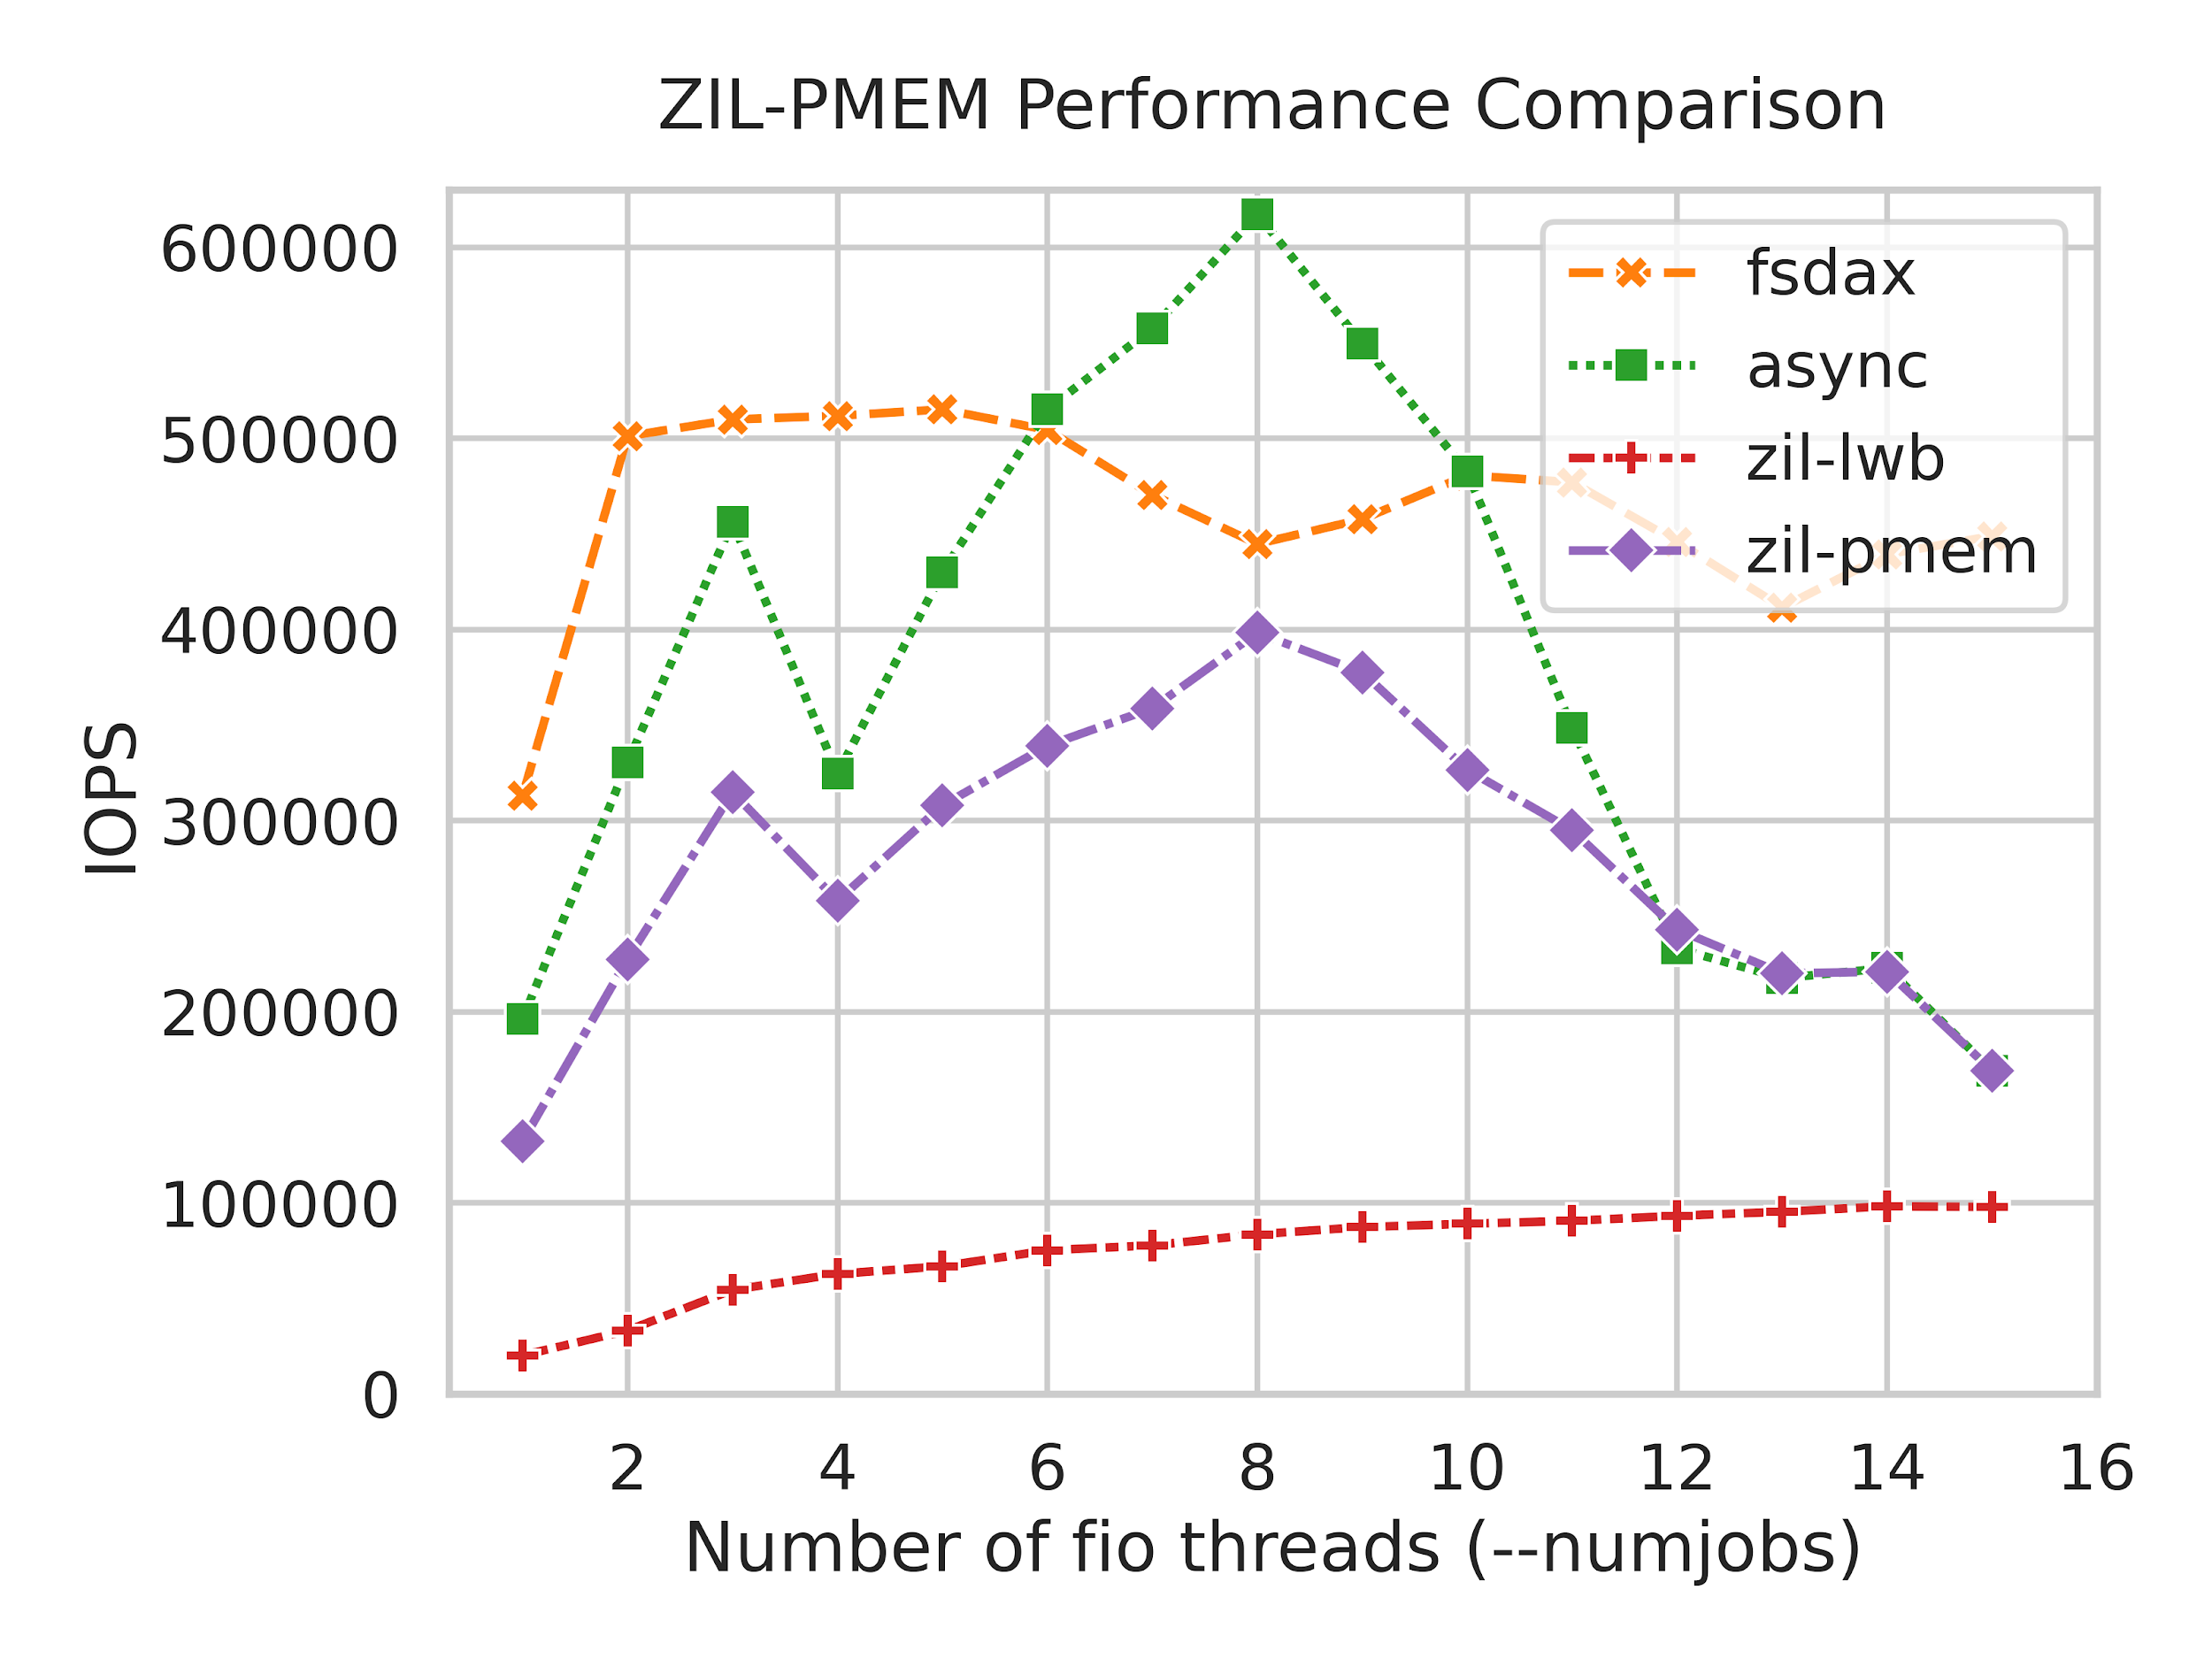
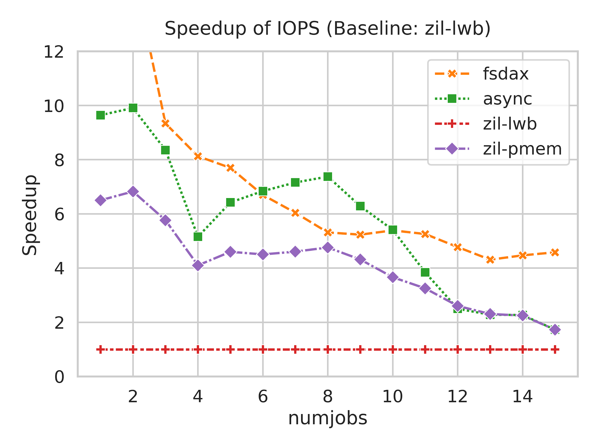
Preliminary Performance Evaluation; 4k writes
Up to 6.8x speedup over ZIL-LWB @ numjobs=2.
4x speedup maintained until peak async IOPS.

Slide 25
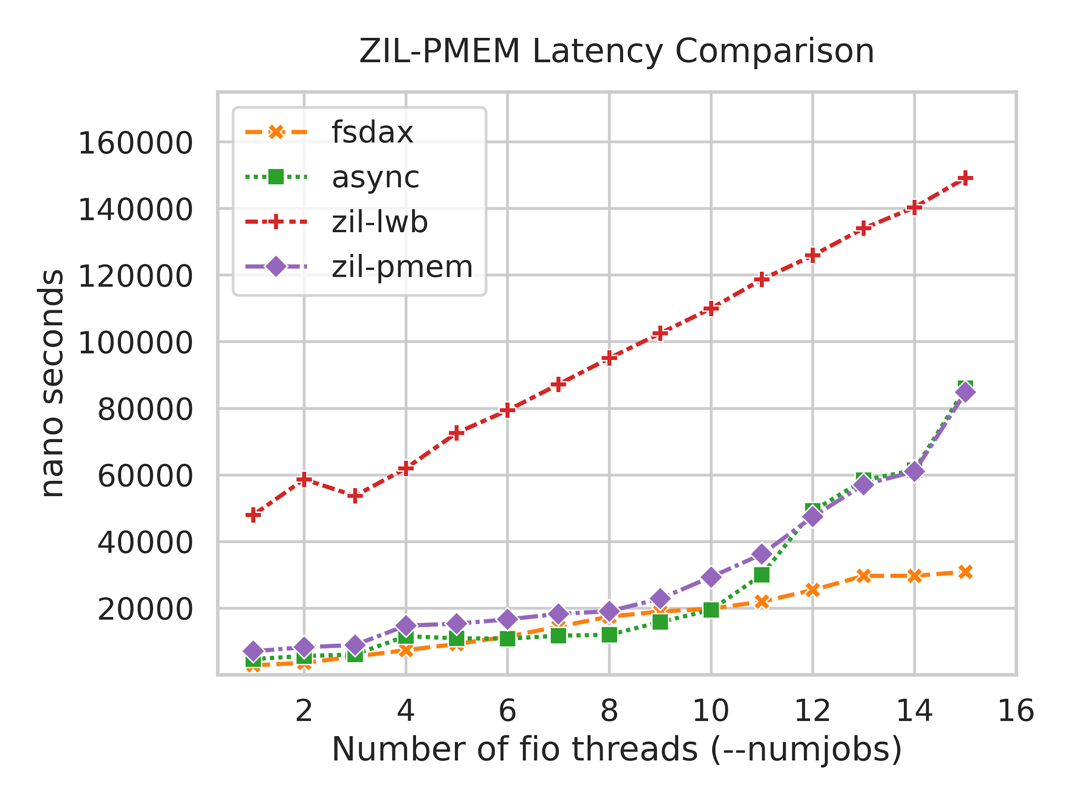
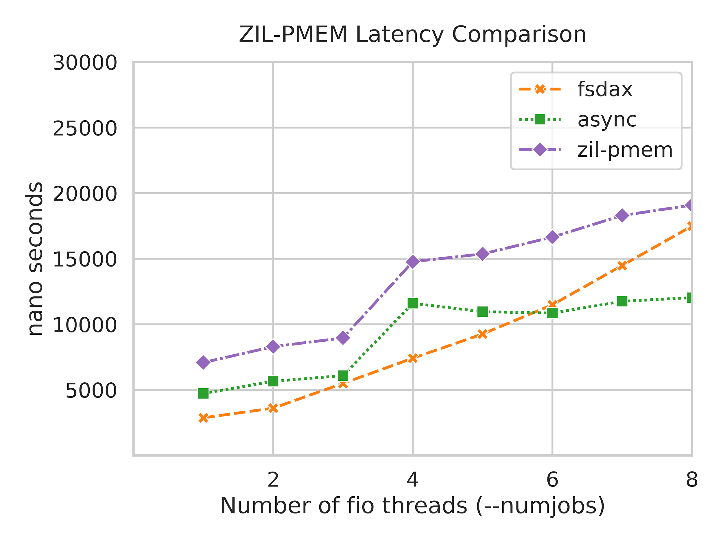
Preliminary Performance Evaluation; 4k writes
latency[us] | 1 | 4 | 8
fsdax | 2.9 | 7.4 | 17.5
async | 4.7 | 11.6 | 12.0
zil-lwb | 48.0 | 62.0 | 95.1
zil-pmem | 7.1 | 14.8 | 19.1

Slide 26
Preliminary Correctness Evaluation
Extensive user-space testing of the PRB data structure.
PRB can be compiled for kernel and user-space.
Testing harness written in Rust (ergonomics + less worrying about correctness of test code).
Testing-strategy:
Replay logic: declarative table-driven tests.
PRB code is structured to allows input and crash scenarios that cannot be triggered easily within ZFS.
Crash tests for assertions that check invalid usage of PRB API.
Basic round-trip tests for log entry write and replay.
gcov-based code coverage used for guidance (70% coverage ATM).
The two major ZIL tests in the ZFS integration test suite pass.
PMEM-specific checks not yet done with current PRB design.

Slide 27
Summary
Major inefficiencies in using /dev/pmem as OpenZFS SLOG device:
~ 40us to 70us of unnecessary latency added per 4k sync write
Root cause: block-device oriented software layers (ZIL LWBs, ZIO pipeline).
Our contribution: ZIL-PMEM, a new ZIL that exclusively targets PMEM.
Integration into ZFS:
PMEM is shared storage pool resource, just like regular devices.
Runtime switch to ZIL-PMEM once PMEM is added to the pool.
In-PMEM data structure
Coarsely chunk up PMEM space. Spread entries over chunks.
High performance
Preliminary evaluation shows up to 6.8x speedup over ZIL-LWB.
Simple but innovative approach to avoid wasting CPU time in PMEM overload situations.
Correctness testing
Methodology is at or above average in academia and industry
Yet notoriously unsatisfactory.
More work to do.

Slide 28
Backup Slides
Some finished, some unfinished. For re-use in final presentation.

Slide 29
Using Persistent Memory as an OpenZFS SLOG
What happens during sys_write()
Modify in-DRAM data structures (DMU objects).
Queue in-DRAM representation of ZIL entries that describe the modifications.
If sync semantics are required: call zil_commit(): packs all queued ITXs into LWBs and persists them to an on-disk linked list.
LWBs are written using the ZIO pipeline.
SLOGs are preferred for LWB allocations.
VFS
ZPL
itx_assign()
if sync:
zil_commit()
modify DMU objects
ZIL
DMU
allocate / dirty ARC buffers
queue:
ITX
ITX
on zil_commit():
ARC
A background thread periodically writes a new version of the on-disk state to the main pool. The update is made atomically. The update invalidates log entries whose effects were persisted as part of the update.
LWB
whenever sync semantics are required
dirty bufs
ITX
ITX
background sync to disk
ZIO
/dev/pmem
Main Pool

Slide 30
Considering Optimizations
Optimizing the ZIO pipeline:
ZIO pipeline latency overhead is known problem; common user complaint. ⇒ no low hanging fruit
All other consumers of ZIO pipeline are throughput-oriented. ⇒ conflicting design goals.
LWB-related optimizations:
PMEM allows writing log entries directly (byte-granular access!)
⇒ LWBs are an unnecessary overhead on PMEM

Slide 31
ZIO is ZFS’s unified infrastructure for performing block IO to the OS block device driver
Many distinguishing features are implemented here: transparent data and metadata checksumming, compression, deduplication, encryption, raidz.
Major users of ZIO pipeline are throughput-oriented. The ZIL is the only latency-sensitive consumer.

Slide 32
Replay: Dependencies (5) TXG Sync Complications
The ZFS on-disk format is a merkle tree rooted at the superblock.
Once sufficient changes to the ZFS in-DRAM state have accumulated (or every 5 seconds) a new merkle tree is written out copy-on-write, except for the uberblock which is updated atomically in-place**. This process is called “txg sync”. Txg stands for transaction group; a monotonically increasing u64.
Updates to ZFS in-DRAM state are always scoped to a txg. At any given point in time there are three txgs in-flight:
The open txg in which new transactions are opened.
The quiescing txg which remains quiescing until all transactions in it have completed their DRAM updates.
The syncing txg: the “txg sync” thread processes all changes made in this txg into a new merkle tree that is written out.
Once “txg sync” is done and the quiescing txg has quiesced it becomes the new syncing txg, the currently open txg becomes quiescing, and a new open txg is started.

Slide 33
Replay: Dependencies (6) TXG Sync Complications
Why is this relevant for the ZIL?
1. Obsolete Entries
The ZIL’s job is to bridge the gap between the time we make our changes in the open txg and the time “txg sync” has finished writing out the merkle tree of that txg.
This means that “txg sync” and the ZIL are inherently racy.
This means that the ZIL can write out an entry for a txg that has already synced.
Those entries must not be replayed because their effect has already been applied.
The solution is to store the txg in which the change that the entry represents will be synced out in the entry header. During replay we ignore entries from txgs that are equal or older to the pool’s synced-out txg at the time it crashed.

Slide 34
Replay: Dependencies (7) TXG Sync Complications
2. Garbage-Collected Entries
ZIL-PMEM implements garbage collection by tracking each chunk’s max_written_txg.
Once a chunk is full it is parked in a per-txg list.
Every time “txg sync” has finished syncing txg synced_txg we know that chunks with max_written_txg == synced_txg contain only obsolete entries. We reset those chunk’s insert offset to zero, invalidate the first entry-header to speed up future recovery, and push the chunk back into the free list for reuse.
The problem: we have to ensure that a log entry’s dependencies have been replayed before replaying it. Without garbage collection we could simply use the “number of entries that must have been replayed up until the start of the current entry’s generation” as a means to detect missing entries. But with garbage collection we eventually destroy entries from synced txgs and thus a single counter would report missing entries even though we would skip these entries during replay (see 1. Obsolete Entries).
The solution is to make the counter per-txg. It is sufficient to store 3 counters because there are at most 3 in-flight txgs at any given time.

Slide 35
Replay: Dependencies (8): Resulting Entry Header
hdr checksum | fletcher4 of this header, including body checksum
body checksum | fletcher4 of the body
body_len | length of body_data below
zil_guid | 128 bit GUID for attribution to the dataset (zil_guid is repeated in the ZIL header)
txg | transaction group in which the entry’s changes will be synced
gen | generation number
gen-scoped id | id identifying the entry within generation .gen
counters | txg | count (number of entries E with E.txg = .txg)
 | 12 | 3
 | 10 | 4
 | 0 | 0 // .txg == 0 indicates empty row
… variable-length body data (length: .body_len) …

Slide 36
Related Work: A Taxonomy
PMEM-only File Systems
Cross-Media File Systems
Other Systems Adapted To PMEM
Testing File System Crash Consistency
PMEM-specific Crash-Consistency Concerns

Slide 37
Related Work: PMEM-only File Systems
Relevant to this thesis due to implementation techniques for synchronous I/O:
In-Kernel: BPFS, PMFS, Nova, Nova-Fortis
Hybrid: Split-FS, Strata
User-space: Aerie, EvFS
Summary:
Many:
In-place atomic updates wherever possible.
Take advantage of PMEM’s byte-granular I/O.
Avoid write-amplification of page-level CoW.
Copy-on-write for larger updates.
NOVA: Per-CPU & per-inode journaling for high concurrency / scalability.
Significantly more relaxed semantics than ZFS!
NOVA Fortis: protection against scribbles, bitflips, handling of MCE.

Slide 38
Related Work: Cross-Media File Systems
Relevant to this thesis with regards to overall architecture & data flow.
Strata
Data-path in user space writes logical write-ahead log to PMEM.
Kernel component “digests” the log and performs aggregated I/O to slower storage.
Good design, PMEM is used on the happy path. No storage pooling, data integrity, redundancy measures.
Ziggurat
PMEM is one of several storage tiers.
Placement prediction choses storage tier, depending on anticipated usage. => no double-writing of data that is imminent to write-ahead logging
Dynamic up-/down-migration if usage pattern changes.
Based on NOVA-Fortis; Focus on tiering, not on synchronous I/O itself.

Slide 39
Related Work: Other Adapted Systems
Relevant to this thesis to show what else is possible.
Unioning of the Buffer Cache and Journaling Layers with Non-volatile Memory
Linux DAX
ext4 fast commits
dm-writecache

Slide 40
Related Work: Testing Crash Consistency
What is the state-of-the-art in testing crash consistency?
All File Systems Are Not Created Equal (Pillai et al., 2014)
Specifying and Checking File System Crash-Consistency Models (Bornholt et al., 2016)
Using Model Checking to Find Serious File System Errors (Yang et al., 2006)

Slide 41
Related Work: PMEM Crash Consistency
What is the state-of-the-art in ensuring that PMEM applications are crash-consistent?
Yat: A validation framework for persistent memory software (Lantz et al., 2014)
pmemcheck (https://pmem.io/2015/07/17/pmemcheck-basic.html)
`pmeminsp`, see Book ProgrammingPersistentMemory Listing
PMTest: A fast and flexible testing framework for persistent memory programs (Liu et al., 2019)
ndctl-inject-error (https://pmem.io/ndctl/ndctl-inject-error.html)

Slide 42
True Slide Graveyard From Here On

Slide 43
> Latency Analysis (ctd.)
What is the maximum performance that we can expect from optimizing (just) the ZIL?
Lat [us]
Speedup
Baseline: sync=1
???
1
Zero-overhead ZIO pipeline
???
1.89
What’s possible with a new ZIL according to the Raw benchmark.
???
3.65
Maximum: sync=0
???
???
Optimizing the ZIO pipeline is insufficient: ZFS needs a new kind of ZIL that exclusively targets PMEM in order to fully exploit its performance benefits.

Slide 44
Replay: TXG Sync Complications
Why is this relevant for the ZIL?
The ZIL’s job is to bridge the gap between the time we make our changes in the open txg and the time txg sync has finished writing out the merkle tree of that txg.
1. Garbage Collection
ZIL-LWB (the old ZIL) is implemented as an on-disk list of log blocks, each of which contains multiple entries. The list head is located in the merkle tree but the log blocks are self-checksumming. Thereby the list can be appended to independently of “txg sync”. However, “txg sync” does the garbage collection: the merkle tree that it writes has its list head moved forward to the first log block with a txg greater (=younger) than the syncing txg. All the log blocks that are now unreachable are freed by “txg sync”.
ZIL-PMEM is not part of the merkle-tree infrastructure. It does garbage collection through a callback after txg sync completes…
2. Replay Correctness Replay can find entries whose txg that have not

Slide 45
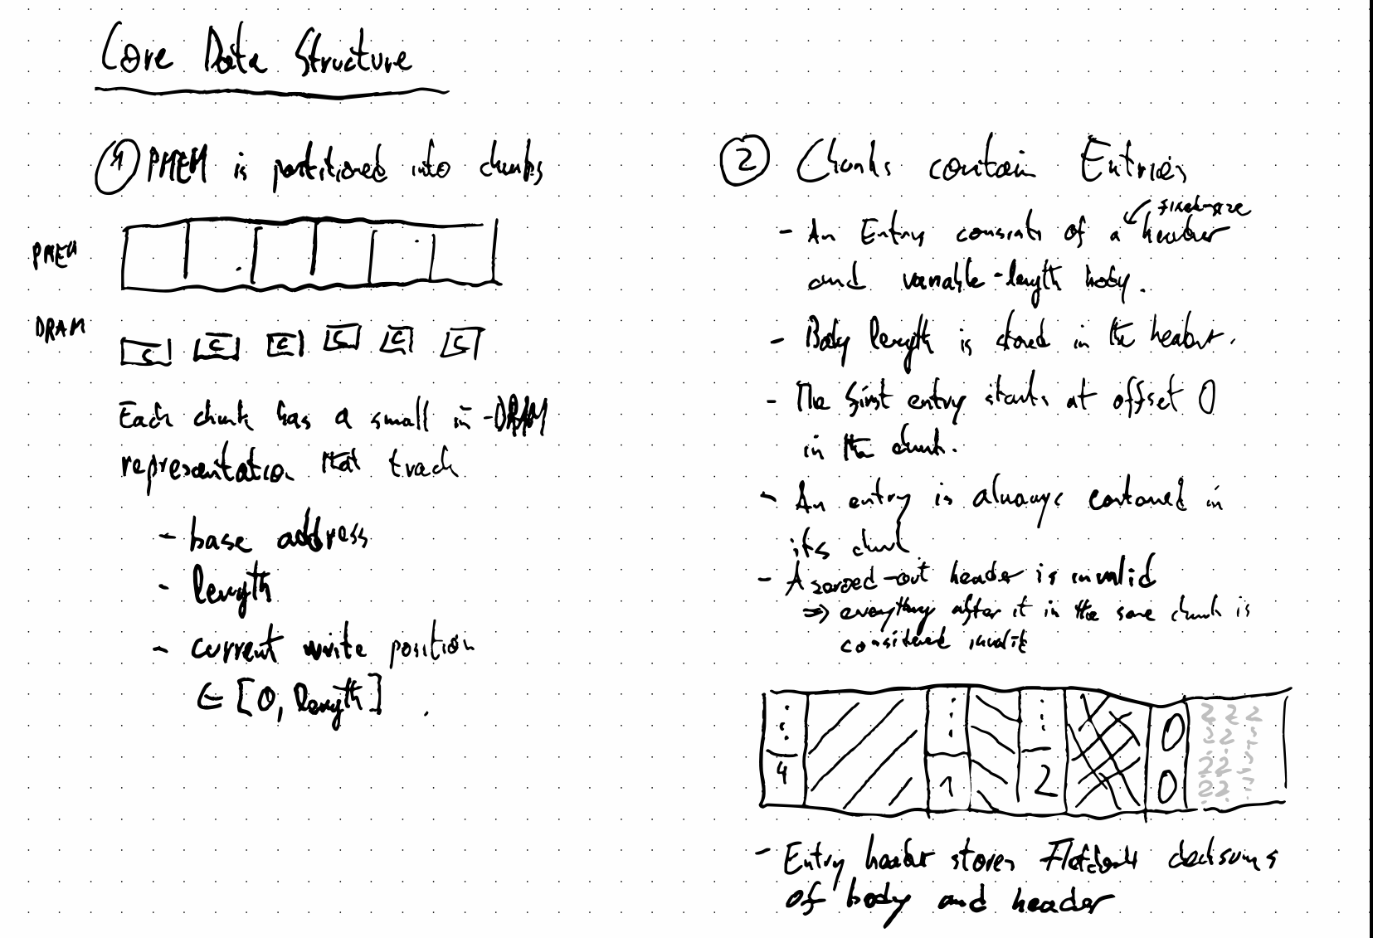

Slide 46
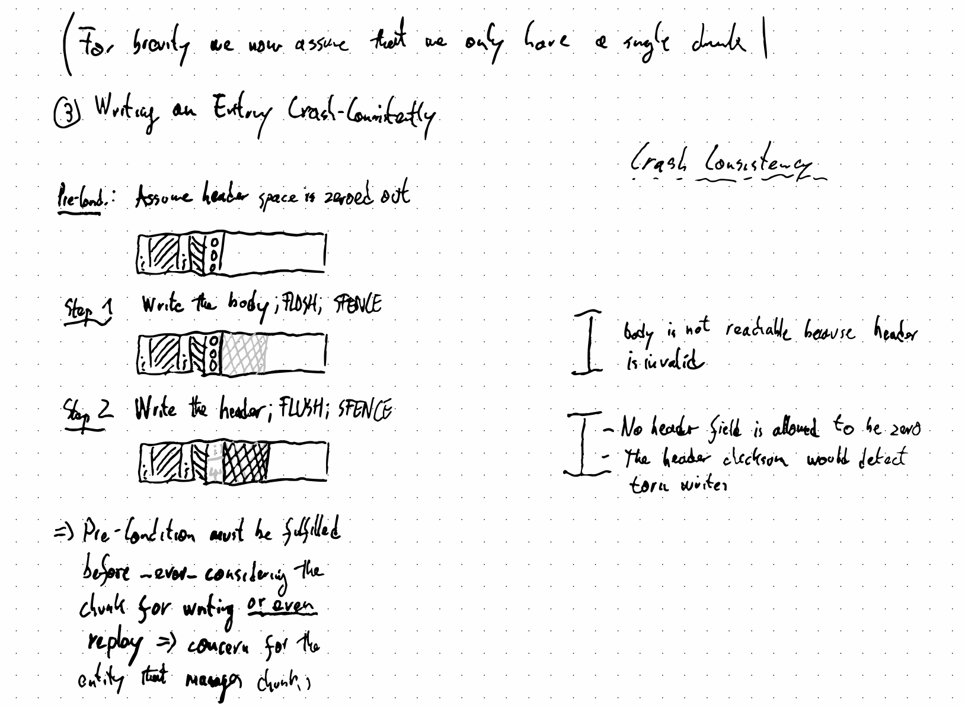

Slide 47
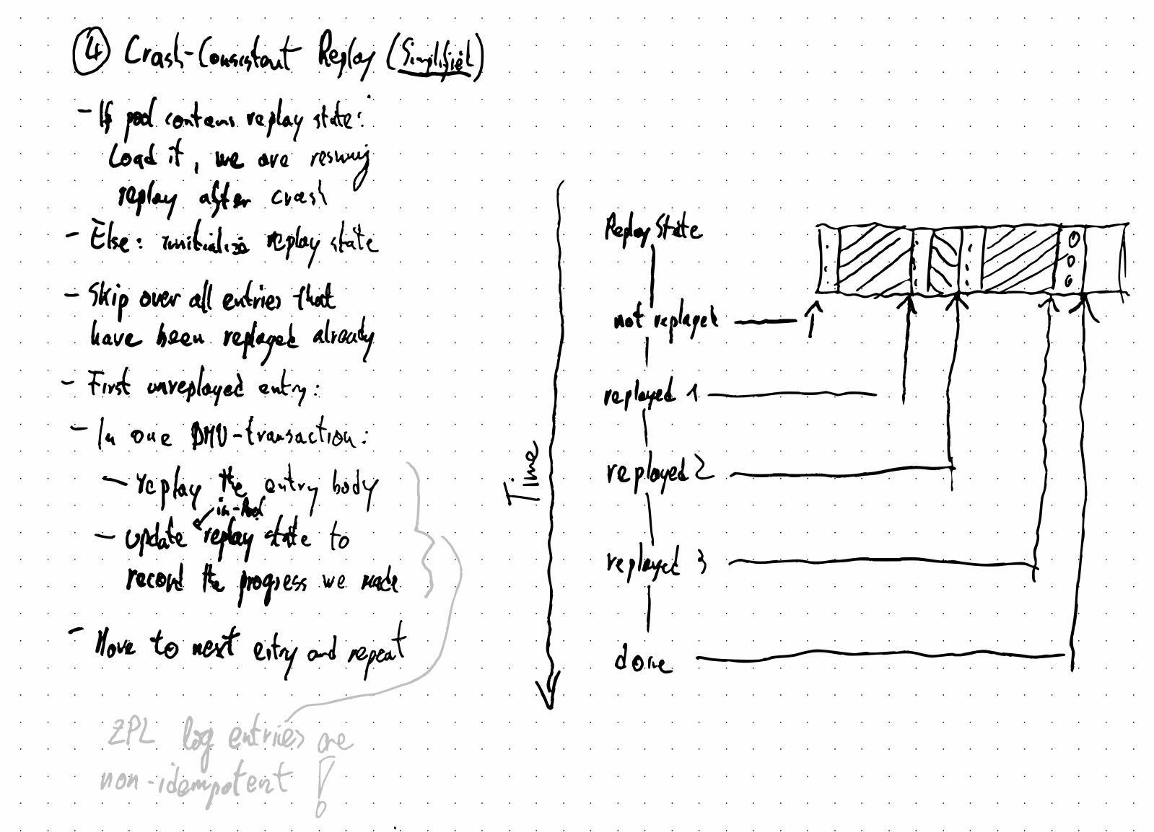

Slide 48
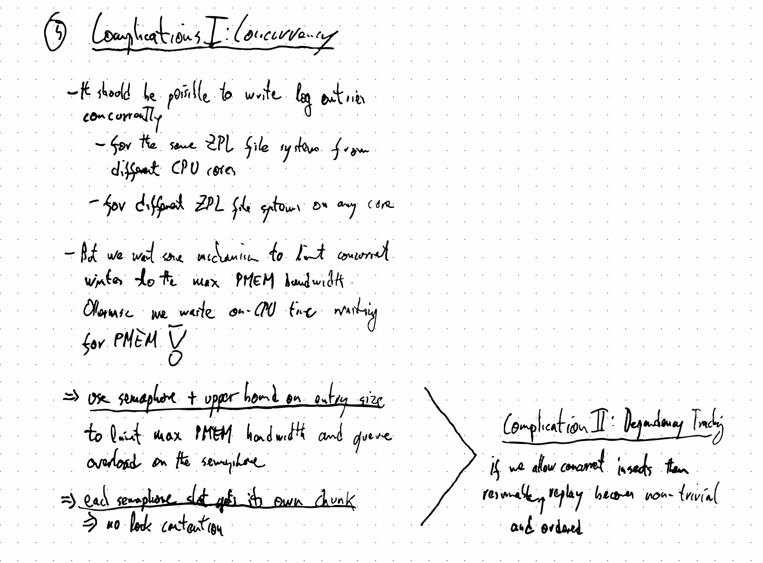

Slide 49
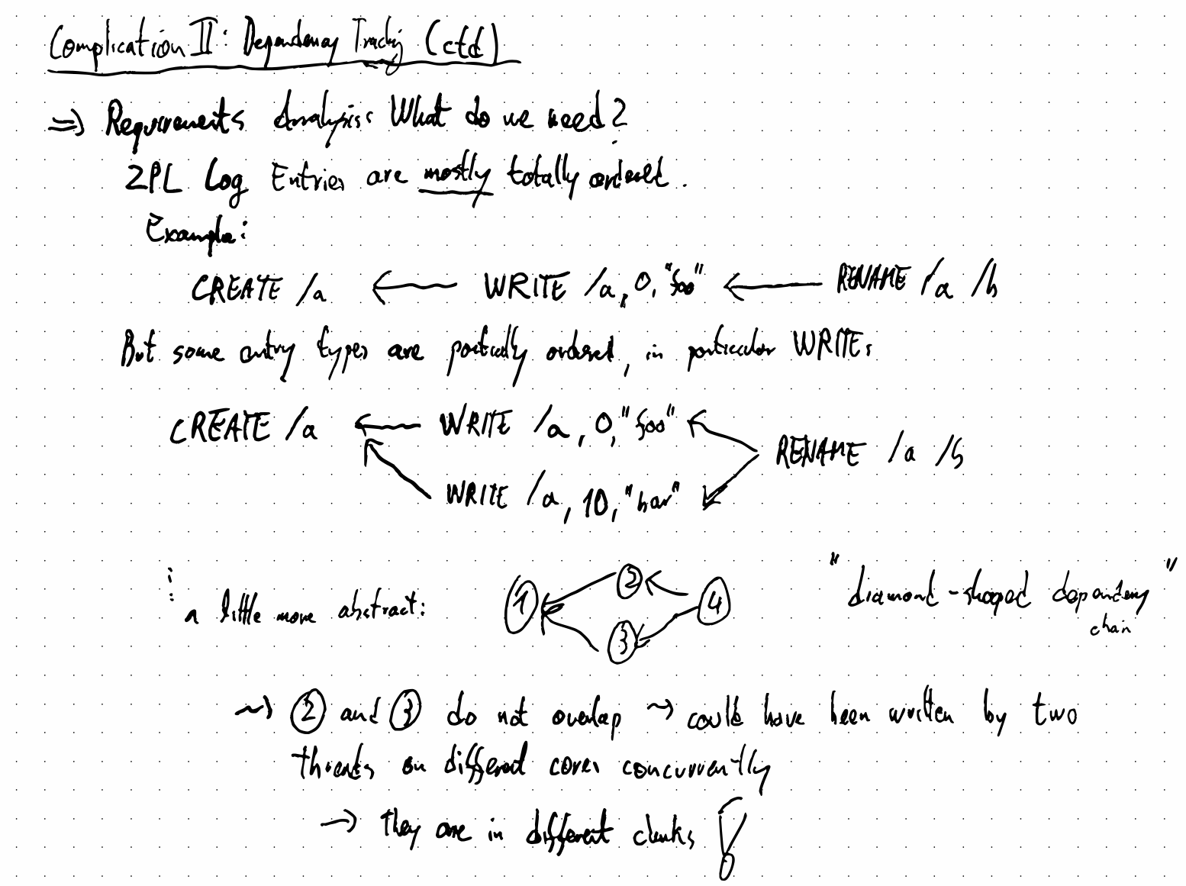

Slide 50
